Slide 1
Brain Blitz
A Trivia Experience
By: Bilal Ahmad, Ahmad NasrAllah, Mohamed Bensassi

Slide 2
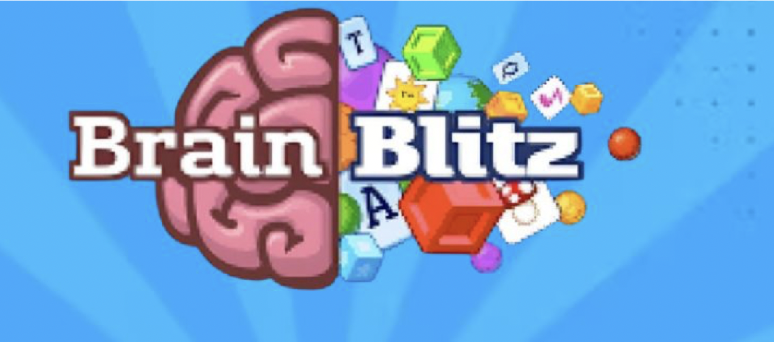
Abstract
Our group project presents an interactive trivia game developed for a computer science course CSC 330, offering both educational value and entertainment. The game ensures an engaging experience for players. Leveraging dynamic question generation and a robust scoring system, users are immersed in challenging gameplay. Efficient database management stores user data, showcasing our skills in data handling. Responsive design principles enable accessibility across platforms. By using modern programming languages and frameworks, we align with industry standards, demonstrating our technical proficiency. In summary, our trivia game combines fun and learning while showcasing our team's software development expertise.

Slide 3
TEAM INTRODUCTION
Ahmad
Nasrallah(Tech Lead)
Mohammed Bensassi (Developer)
Developers write code based on project requirements and collaborate with team members like Tech Leads and QA Engineers to ensure project progress. They also document their code for clarity and engage in continuous learning to enhance their skills.
As a Tech Lead, I provide technical guidance and leadership, mentor junior developers, review code, solve technical issues, and communicate with stakeholders to ensure project success.
Bilal Ahmad - (Project Manager & QA Engineer)
As a Project Manager/BA, I define project objectives, scope, and timelines while allocating resources. I facilitate communication among teams, oversee requirement documentation, like user stories, and manage their prioritization and completion for efficient project progress tracking.

Slide 4
Obstacles and Solutions
Linking Front and back end
We tried to link the frontend and backend of a trivia game using Java, but reverted to a basic front end as we had issues connecting the to the API we wanted but we couldn’t do it in time for the presentation.
The Quiz has a repeating question issue that was caused by the shuffle function that we are currently working on a fix for it.
Repeating Questions
Creating a server
We set up a Java-based backend using a simple HTTP server using Java's built-in HttpServer class, running on port 8000. It defines multiple endpoints to handle different types of requests, such as logging in, registering, starting a game, submitting answers, and fetching questions. Each request type is handled by a specific method that processes POST data received from clients. These methods utilize a lambda-style approach to abstract the handling logic for each endpoint, allowing for streamlined processing of incoming data such as usernames, passwords, and game-related commands.
Leaderboard
The Leaderboard.java class in our application is designed to manage and persist player scores for a trivia game using a HashMap. It supports loading and saving scores from a file, updating individual scores, and retrieving a sorted list of top scores.
Group Member Dropped the class
Since our group member left, it affected us by reallocating tasks and slowing down progress as we adjusted to the change. We documented the work completed by the departing member and redistributed responsibilities among the remaining team to ensure continuity in development. Holding a knowledge-sharing session helped us transfer their tasks smoothly, trying to minimize the impact on the project timeline and quality.

Slide 5
MVPs
Must Have: User Registration
Score tracking
Final score with questions from quiz and their correct answer
Leaderboard
Should Have: Leaderboard Category selection

Slide 6
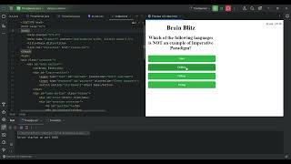
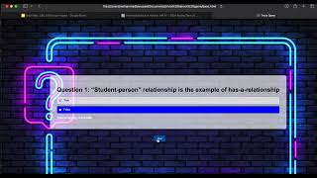
VISUAL DEMONSTRATION

Slide 7
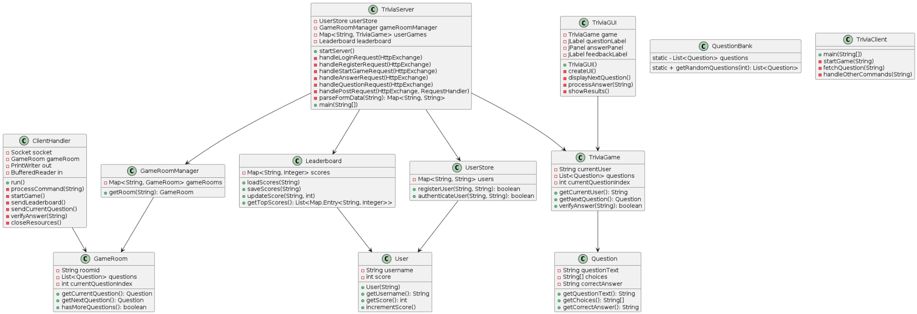
UML Diagram

Slide 8
Future Plans
Multiplayer Game Rooms using an actual server
Constantly Updating Leaderboard
Multiple Categories

Slide 9

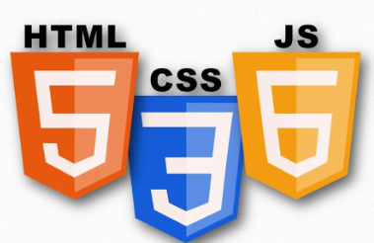

TECHNOLOGY USED
Coding
Platform used
Programming
Language used

